Slide 1
THE COLLISION THEORY

Slide 2
For the reaction A + B → C, A and B must collide
For the reaction A → B + C, A must collide with itself or with the walls of the container

Slide 3
Effective Collisions
An effective (successful) collision is a collision that occurs with enough energy and with particles aligned correctly
In an ineffective (unsuccessful) collision, the colliding particles remain unchanged

Slide 4
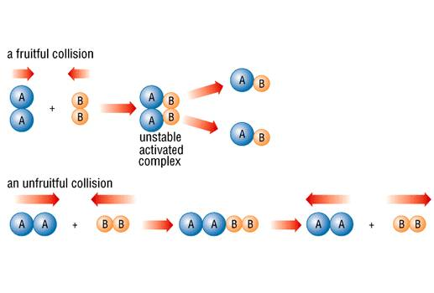

Slide 5
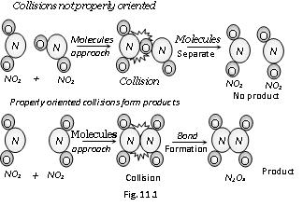

Slide 6
Rate of the reaction α the # of collisions; that is, the rate increases if the # of collisions increases
Rate of the reaction α the % effective collisions; that is, the rate increases if the % that are successful increases

Slide 7
During a collision, the sum of PE + KE remains constant; that is, as particles collide they slow down and KE decreases but PE increases

Slide 8
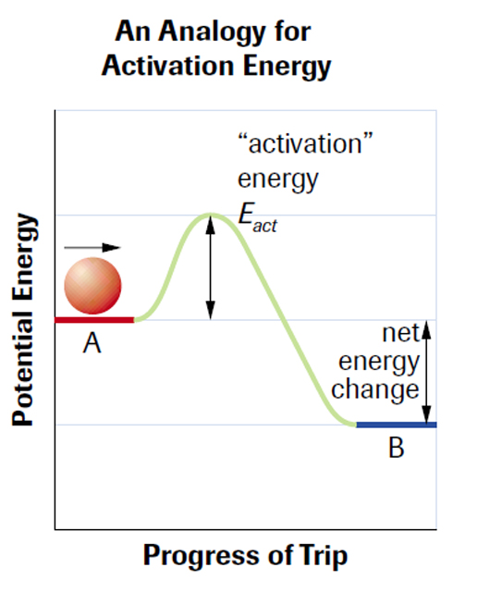
Activation Energy

Slide 9
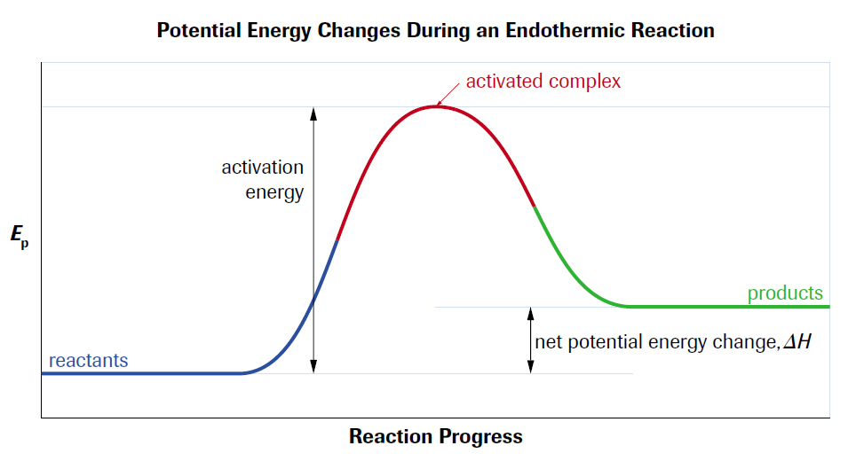
Activation Energy: the minimum energy with which reactant particles must collide to produce an effective collision

Slide 10
Activated complex: an unstable chemical species containing partially broken and partially formed bonds

Slide 11
